Slide 1
LEMI’S MAIN RIG 3D DRAWING
24/10/2024
IGOR RANGEL CORRÊA FERREIRA
igorrangell@hotmail.com
(31) 99906-9584

Slide 2
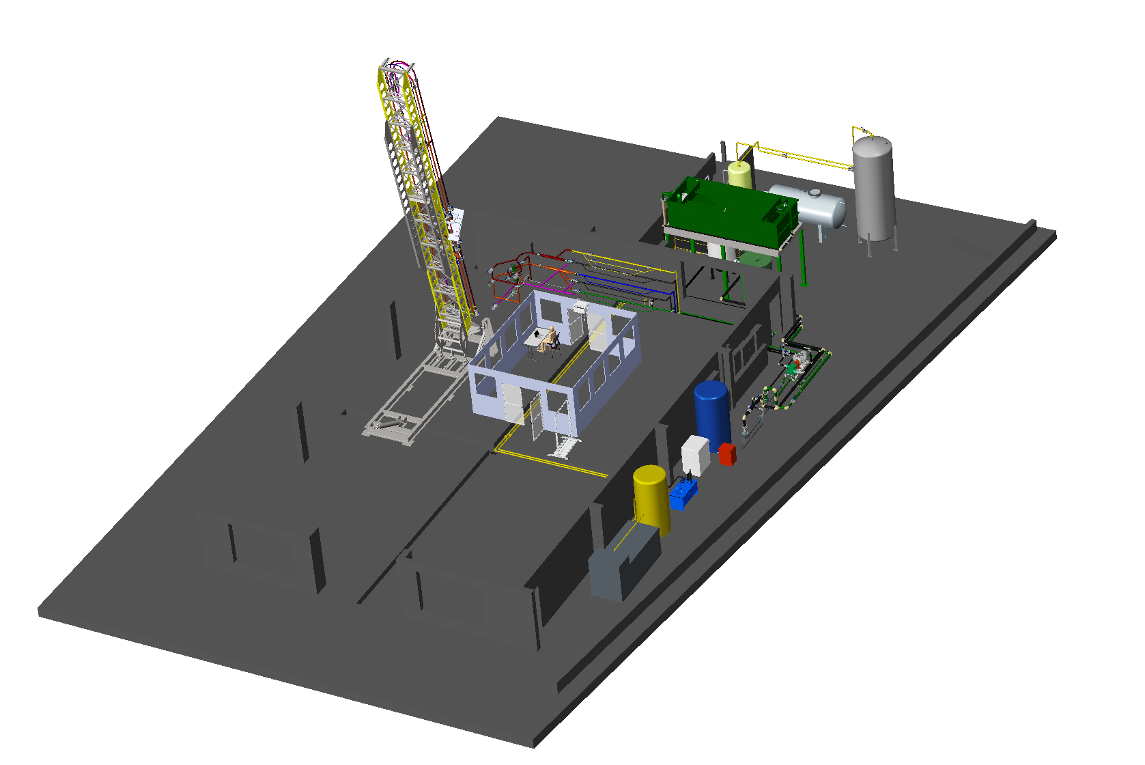
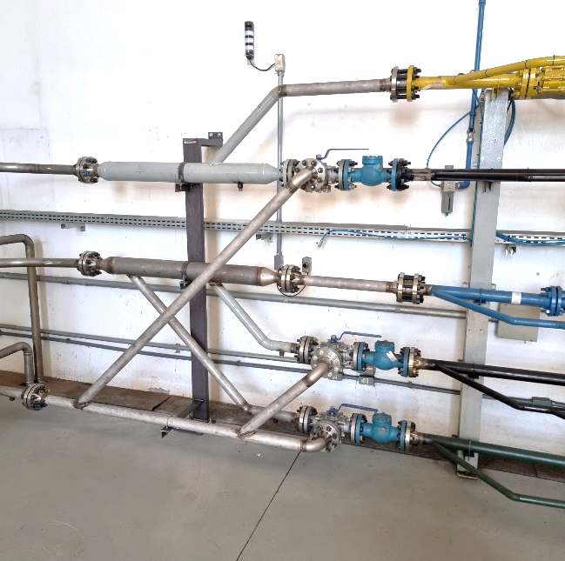
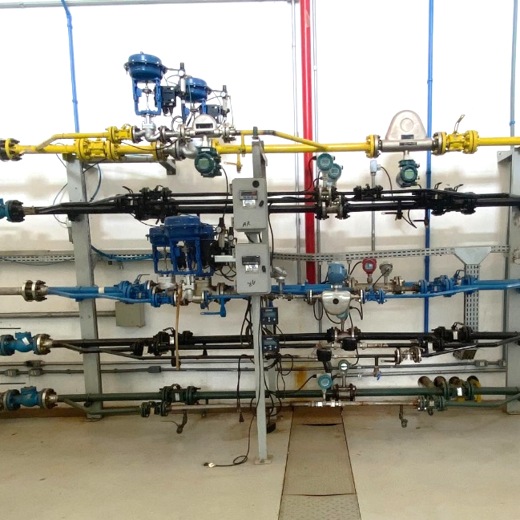
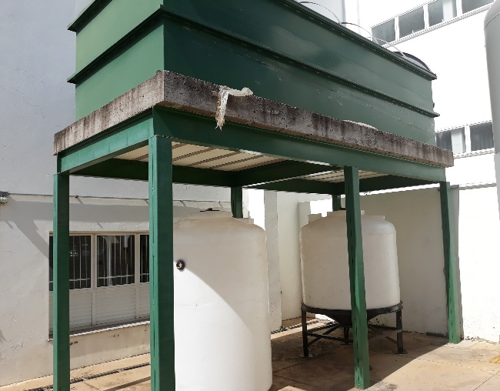
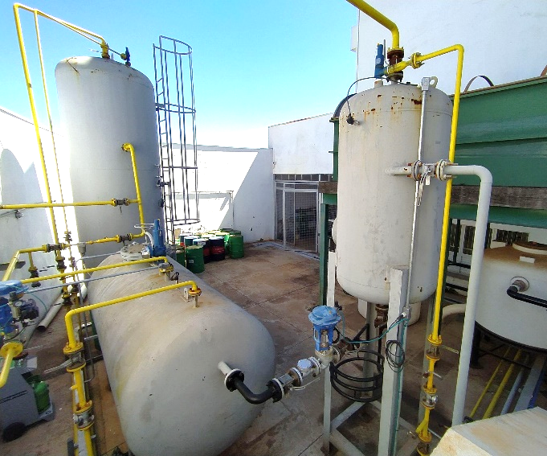
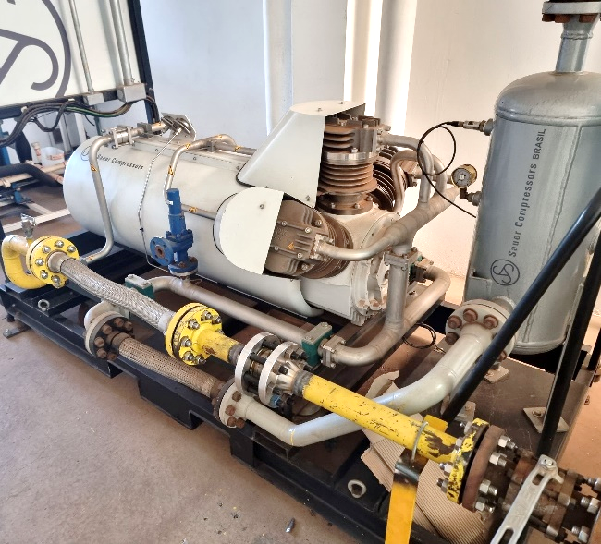
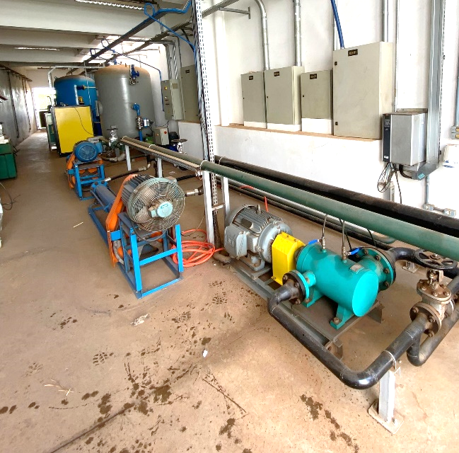
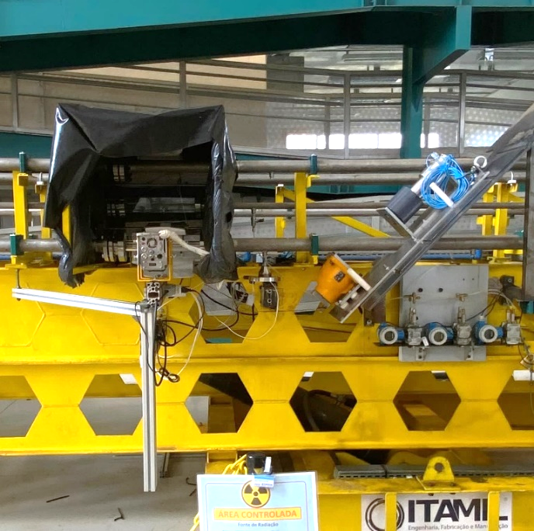
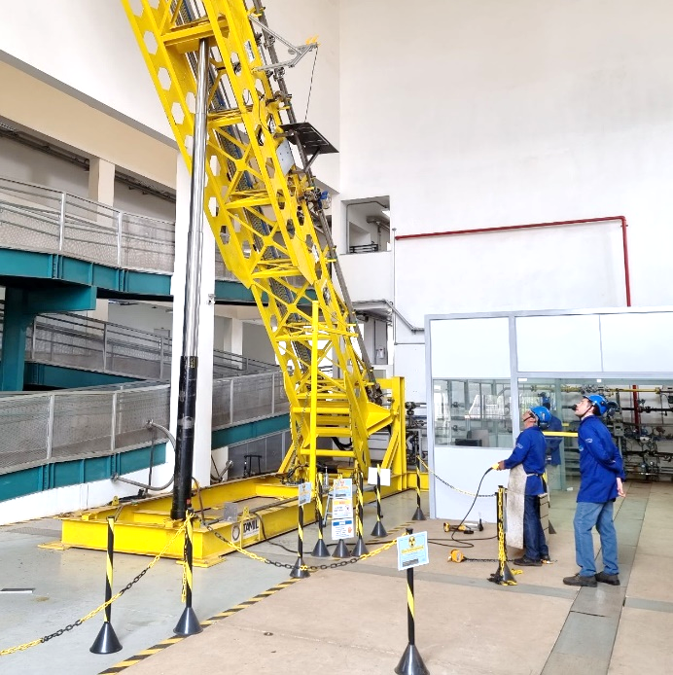
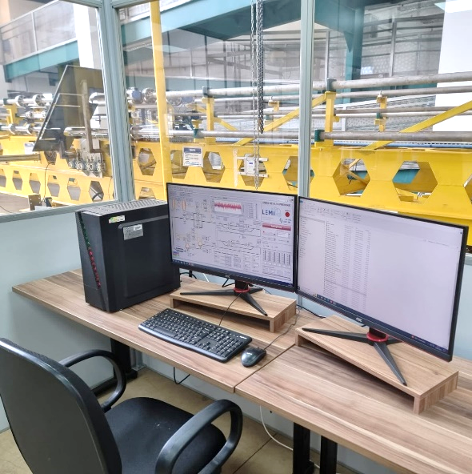
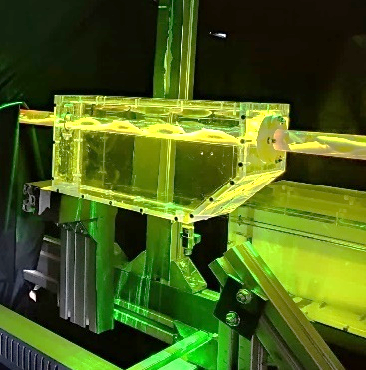
LEMI’S MAIN RIG
Fluid mixing and monitoring section
Storage tanks and separators
Multiphase measurements circuit
Machine room
Control and operation room
PIV & PLIF Equipment

Slide 3
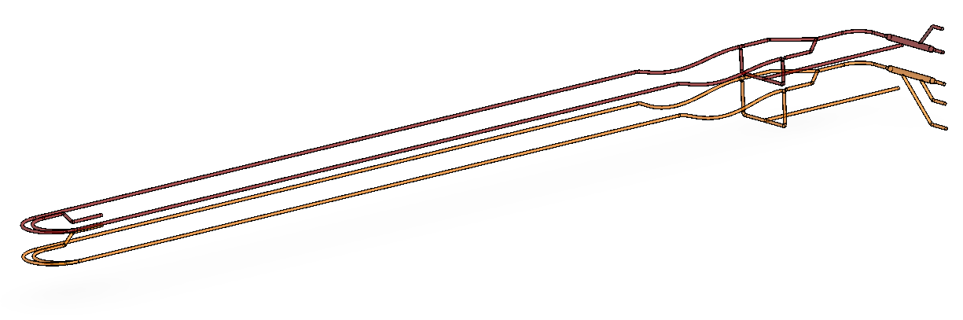
MAIN CHARACTERISTICS
A simplified version of LEMI’s main RIG is developed for the CFD simulations;
Only the fluid mixing section and the multiphase measurement circuit are represented in the simplified version;
The goal is to analyze the fluids behavior inside the mixer and the measurement circuit.
High Pressure Line
Low Pressure Line
HP = High Pressure (red line)
LP = Low Pressure (Orange line)

Slide 4
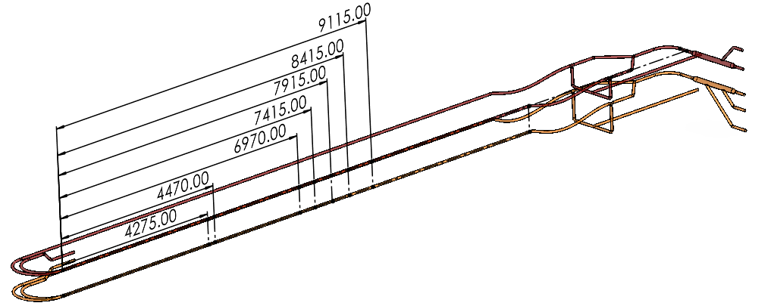
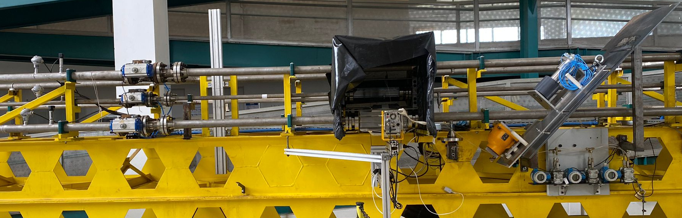
INSTRUMENTATION’S POSITION
The visualization window and gamma-ray densitometer, as well as the temperature and pressure sensors are located close to the center of the multiphase measurement circuits, as follows:
Differential pressure take 3
HP = High Pressure (red line)
LP = Low Pressure (Orange line)
Differential pressure take 2
Absolute
Pressure
Gamma-ray densitometer
Temperature
Differential pressure take 1
Dif. Pressure takes
Visualization window
(with high-speed cameras)
Temperature
& Pressure
Visualisation Window
Gamma ray
densitometer
End of the curve

Slide 5
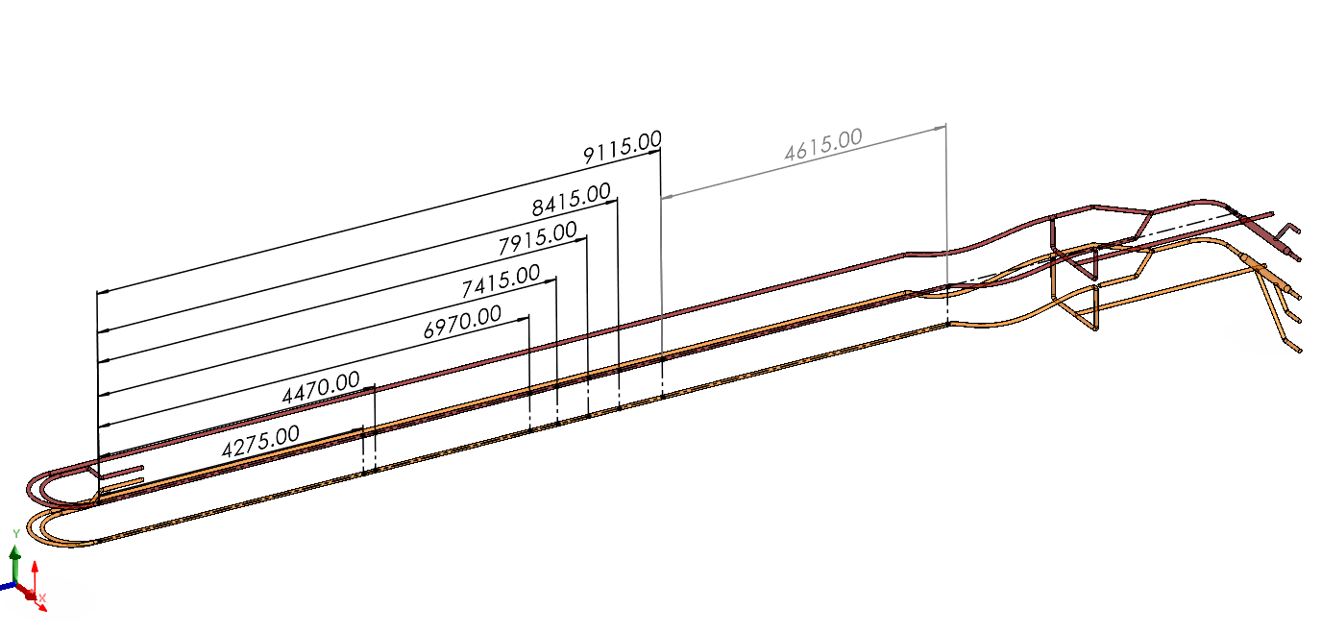
MAIN DIMENSIONS

Slide 6
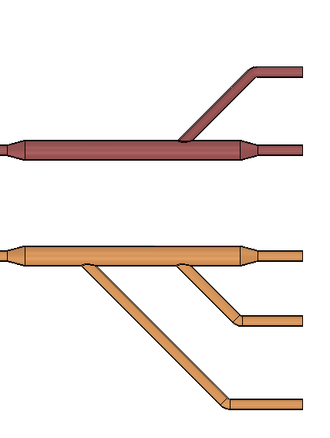
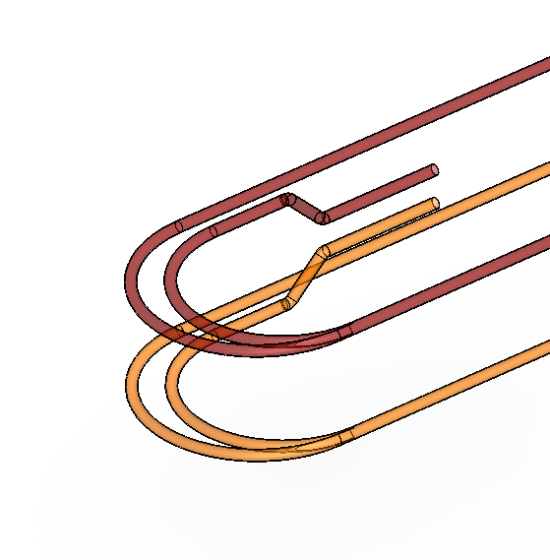
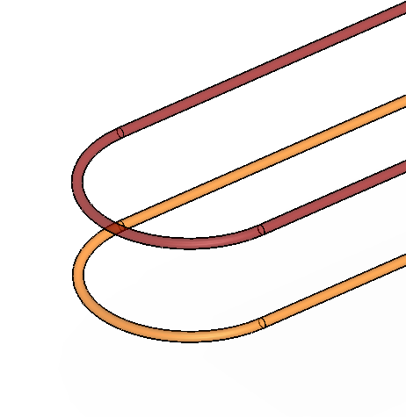
MIXTURES OPTIONS
Variable | High pressure line | Low pressure line
Max operating pressure | 15 bar(a) | 7 bar(a)
Temperature range | 20 ºC – 50 ºC | 15ºC – 50 ºC
Max gas flow rate | 463 Nm³/h | 268 m³/h
Max liquid flow rate | 60 m³/h | 60 m³/h
Liquid | Lubrax Turbina 22 | Lubrax Turbina 22 / Water
Gas | Sulphur hexafluoride | Air
Line sizes | 1", 2" | 2"
Density Ratio | 8 | >500
Horizontal line length | 30 m | 30 m
Inclinations | -90º to 90º | -90º a 90º
HP = High Pressure (red line)
LP = Low Pressure (Orange line)
For setups 1, 2 & 3 :
HP SF6 (gas)
*setups 1 & 2 :
*setup 3:
HP Oil (liquid)
LP Air (gas)
LP Oil (liquid)
LP Water (liquid)
Closed ends

Slide 7
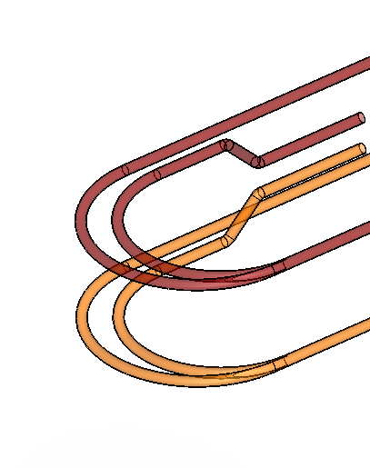
MIXTURES OPTIONS
Variable | High pressure line | Low pressure line
Max operating pressure | 15 bar(a) | 7 bar(a)
Temperature range | 20 ºC – 50 ºC | 15ºC – 50 ºC
Max gas flow rate | 463 Nm³/h | 268 m³/h
Max liquid flow rate | 60 m³/h | 60 m³/h
Liquid | Lubrax Turbina 22 | Lubrax Turbina 22 / Water
Gas | Sulphur hexafluoride | Air
Line sizes | 1", 2" | 2"
Density Ratio | 8 | >500
Horizontal line length | 30 m | 30 m
Inclinations | -90º to 90º | -90º a 90º
HP = High Pressure (red line)
LP = Low Pressure (Orange line)
For setup 4 :
HP SF6 (gas)
Closed end
HP Oil (liquid)
LP Water (liquid)
or
LP Oil (liquid)
LP Air (gas)
Closed ends

Slide 8
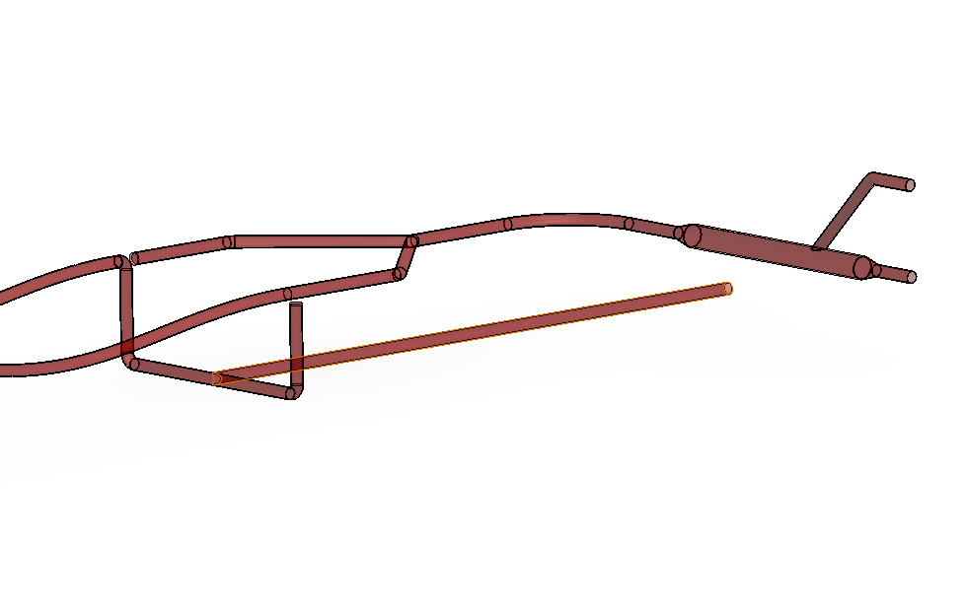
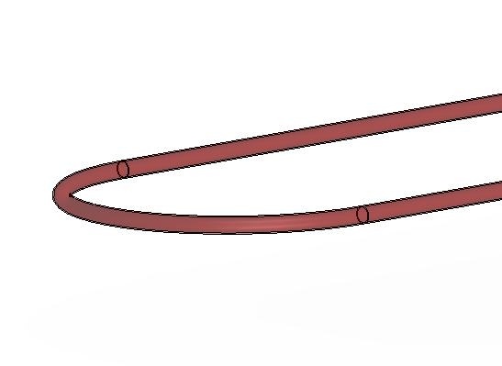
High pressure - Setup 1
outlet
inlet

Slide 9
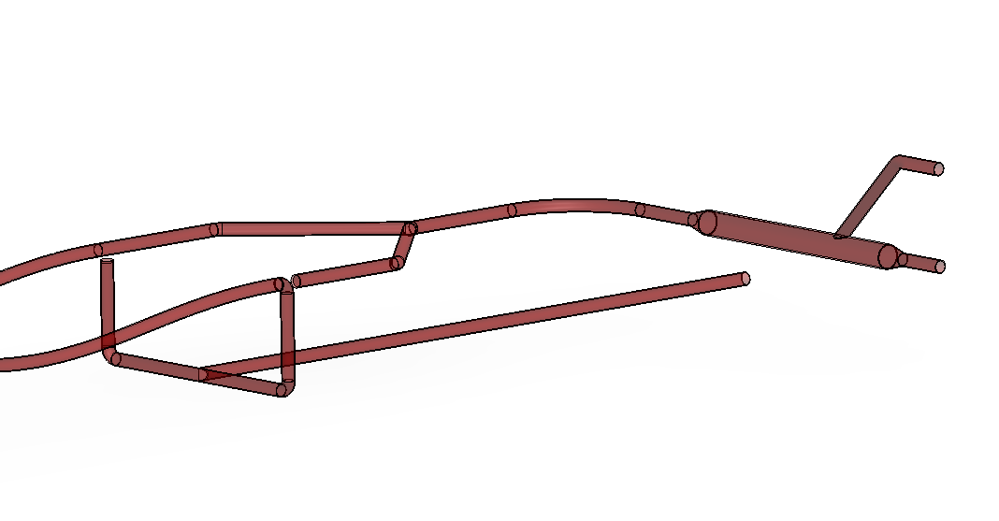
High pressure - Setup 2
inlet
outlet

Slide 10
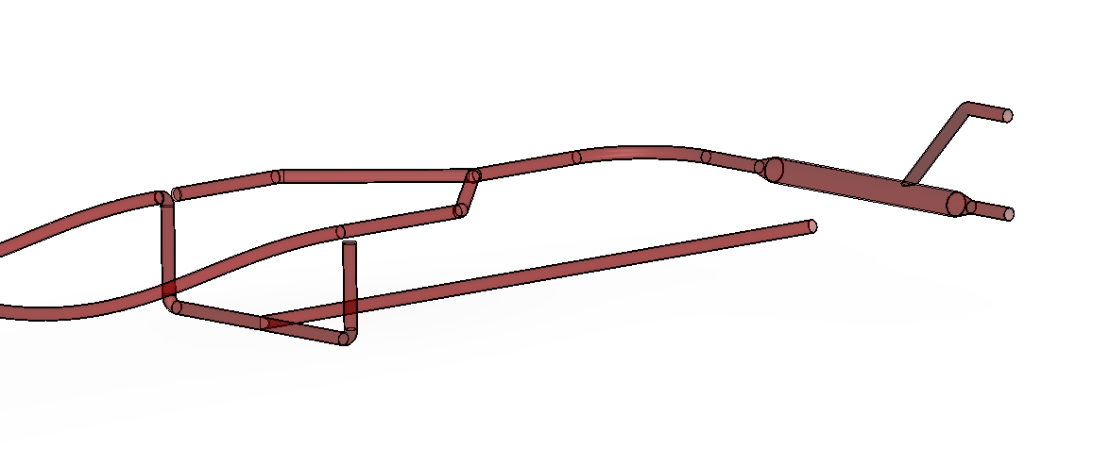
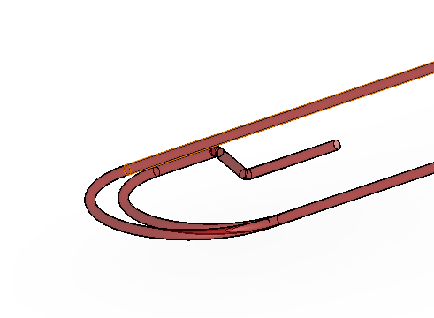
High pressure - Setup 3
outlet
inlet

Slide 11
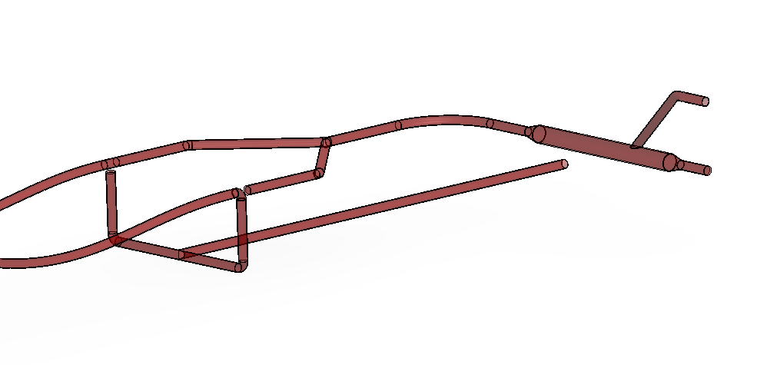
High pressure - Setup 4
inlet
outlet

Slide 12
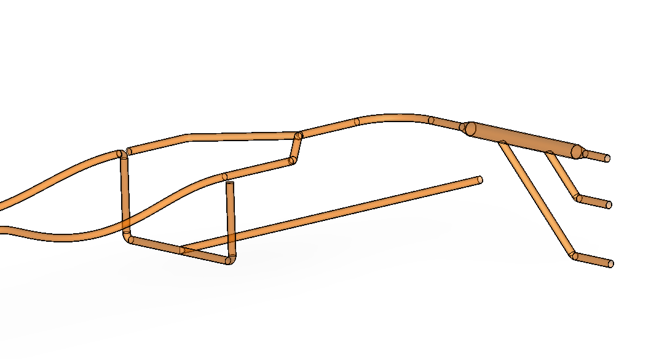
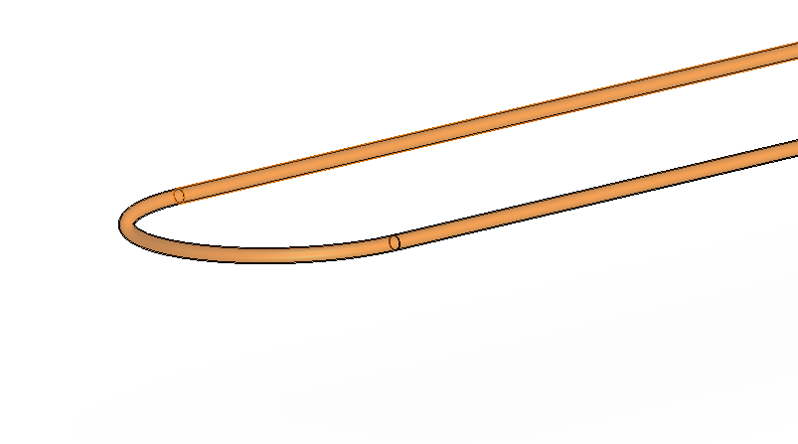
Low pressure – Setup 1
outlet
inlet

Slide 13
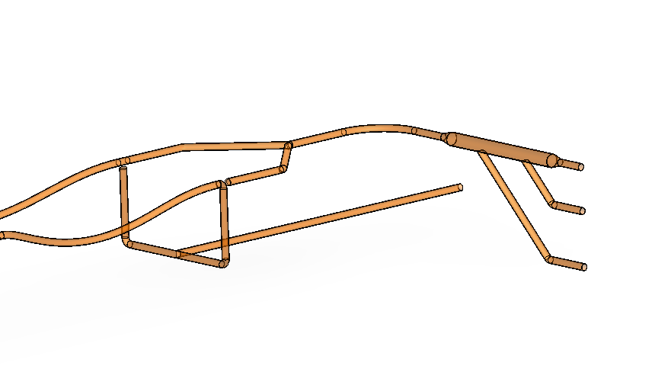
Low pressure – Setup 2
inlet
outlet

Slide 14
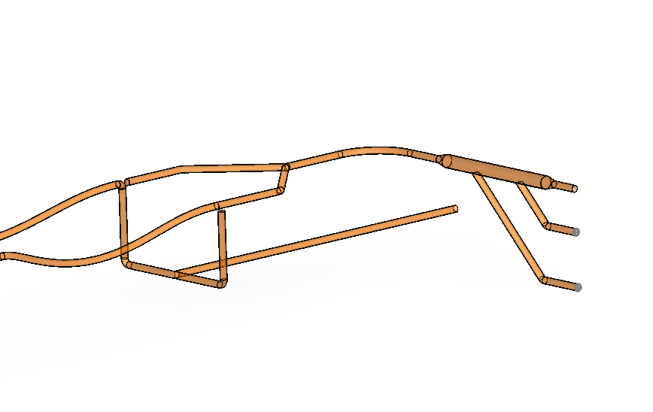
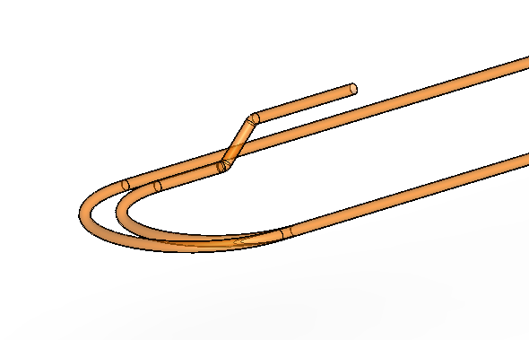
Low pressure – Setup 3
outlet
inlet

Slide 15
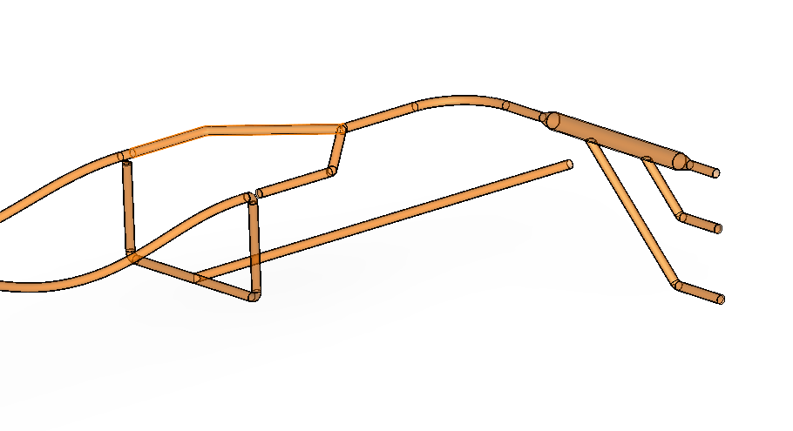
Low pressure – Setup 4
inlet
outlet

